Slide 1
BRITISH AIRWAYS
ANALYSING CUSTOMER REVIEW DATA
Presented by:
Ramana Kulanthaivelu

Slide 2
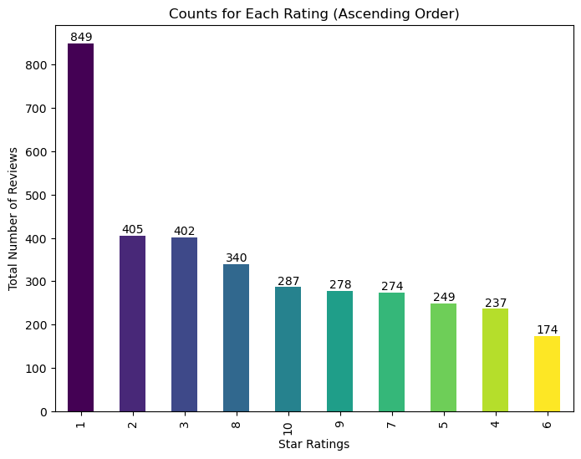
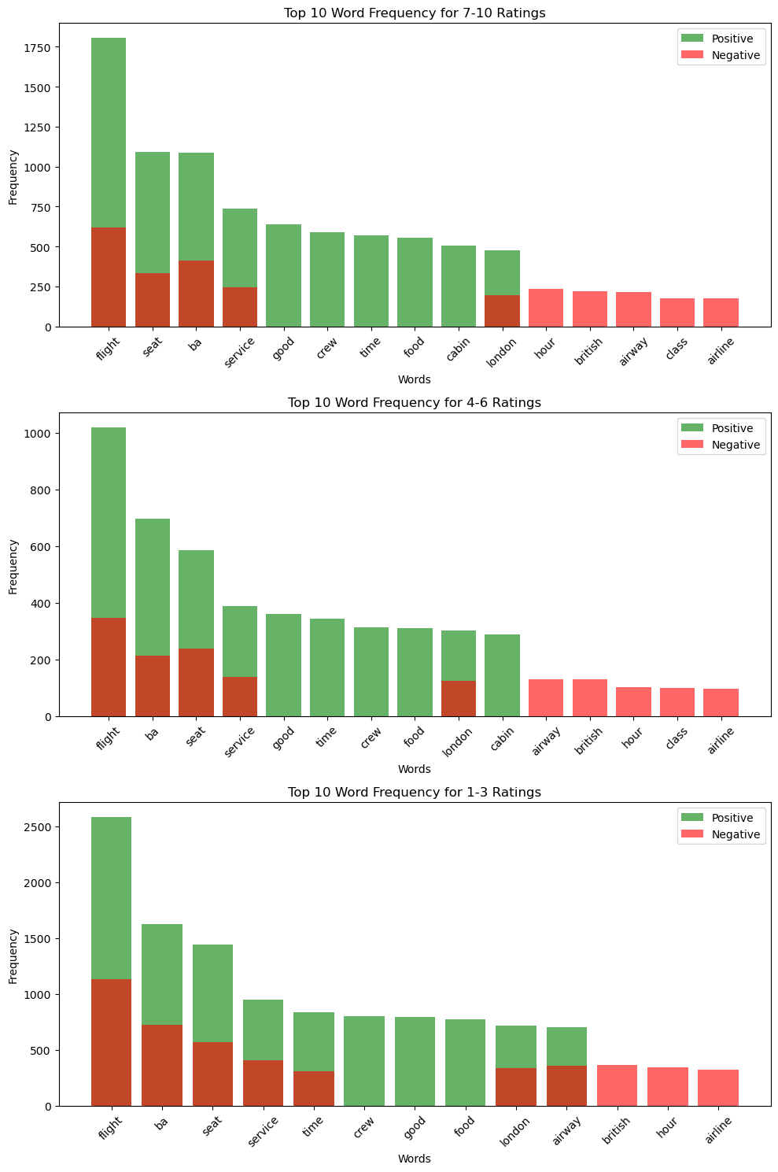
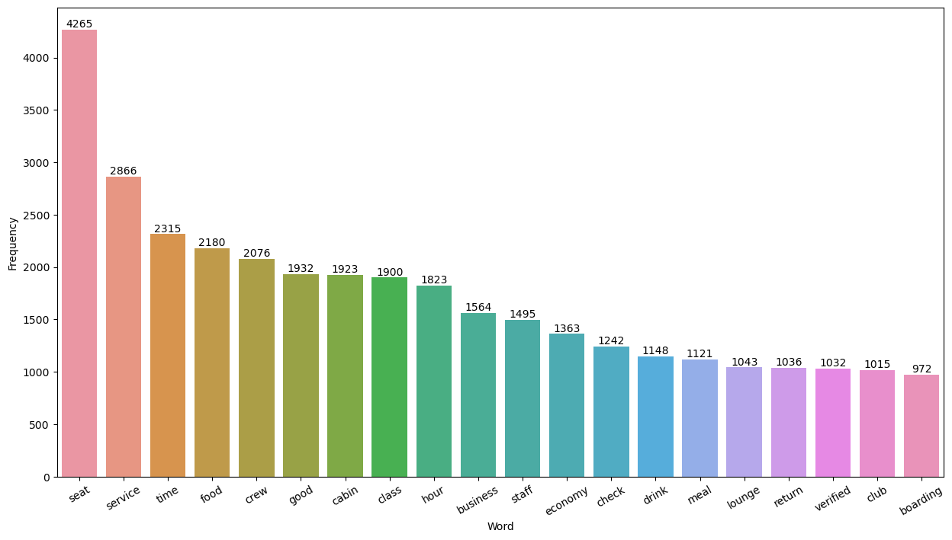
Positive features like prompt check-in, amiable service, and cosy seating are emphasised in the rating group of 7–10.
On the other hand, reviews with lower ratings (1-3) voice discontent with things like crammed seats, inadequate service, and unforeseen difficulties encountered while travelling.
The ratings in the 4-6 range are a mixed bag; there are some good comments about the quality of the food and the comfort of the seats, but there are also some bad ones about the unfriendly staff and the mediocre service.
Overall Ratings:
4.6 / 10

